Slide 1
WEBMONK (COURSE DAY - 17)
Topics covered:
* What is State Management?
* Actions, Dispatch, State, Mutations Redux

Slide 2
WHAT IS STATE MANAGEMENT?

Slide 3
STATE MANAGEMENT
* state-management is the implementation of a design pattern, with the help of this design pattern we can synchronize the state of the application throughout all components of the application. This design pattern makes the implementation of services and handling of data coming from the database very easy.

Slide 4
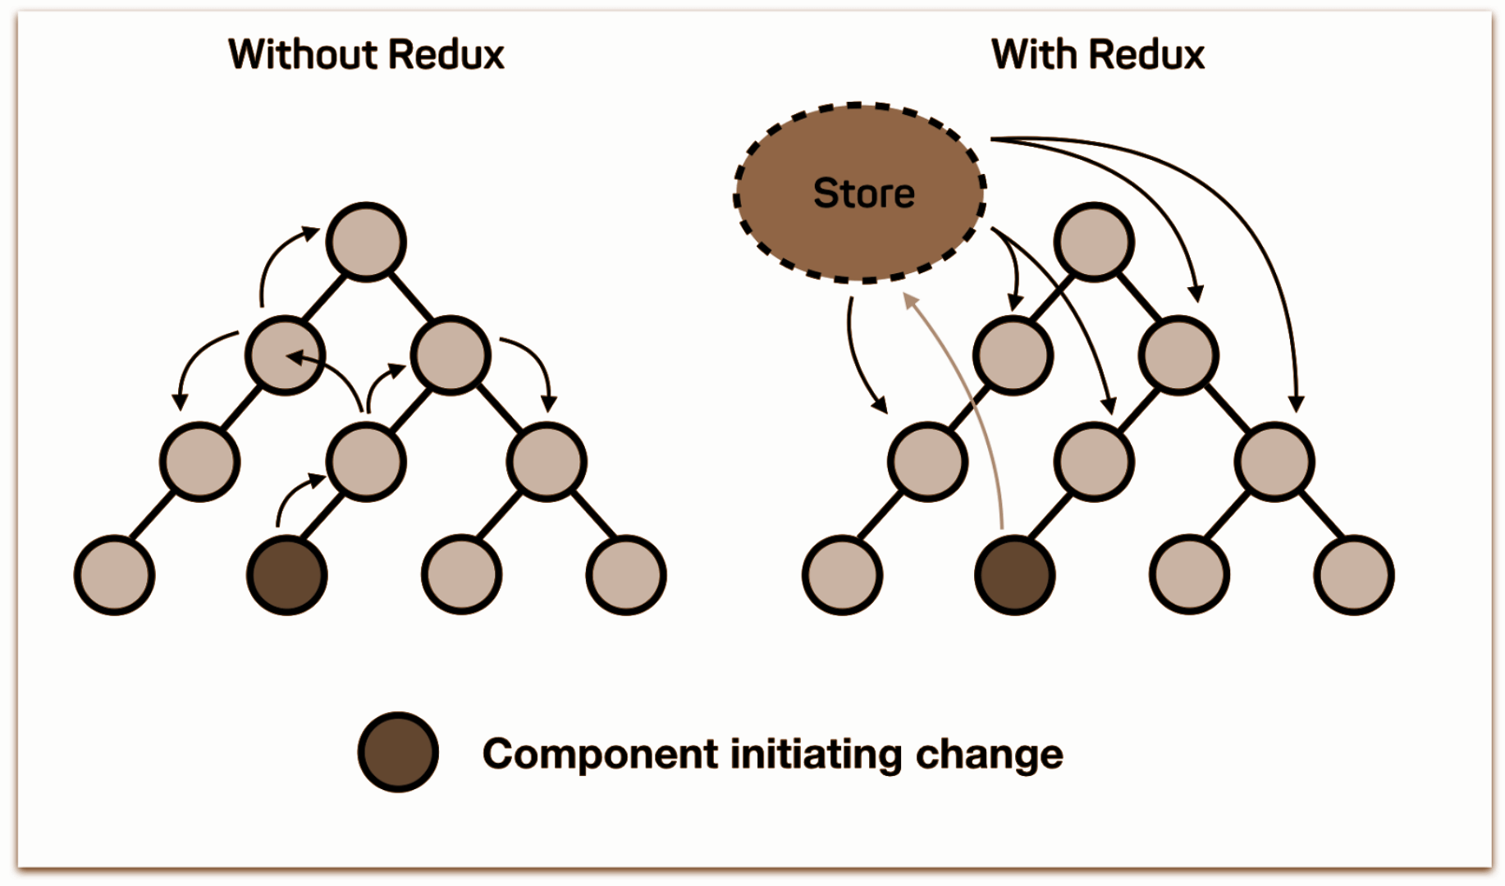
WHAT & WHY REDUX
redux is an open-source JavaScript library for managing application state.
* managing state in JavaScript applications is very challenging
* redux employs a predictable state container to simplify state management​
* execution of an application is an initial state followed by a series of actions​
* each action reduces the state to a new predictable state, to which the application user interface transitions.

Slide 5
3 PRINCIPLES OF REDUX
To enable state changes to be predictable, the following constraints applied to state changes​
* Single Source of Truth​
* State is Read-Only​
* Changes are made with Pure Functions​

Slide 6
HOW REDUX WITH REACT WORK?
* An action is dispatched when a user interacts with the application.
* The root reducer function is called with the current state and the dispatched action. The root reducer may divide the task among smaller reducer functions, which ultimately returns a new state.
* The store notifies the view by executing their callback functions.
* The view can retrieve updated state and re-render again.

Slide 7
LET’S DIVE INTO CODE, SHALL WE?

